Slide 1




NEXT GEN EMPLOYABILITY PROGRAM
Creating a future-ready workforce
Team Members
College Name
Student Name :Dharanisha K P
Student ID : 960221104050
Arunachala college of Engineering for women

Slide 2

CAPSTONE PROJECT SHOWCASE
Project Title
Car Rentals Application with Django Framework
Abstract | Problem Statement | Project Overview | Proposed Solution | Technology Used | Modelling & Results | Conclusion

Slide 3
Abstract
The car rental application built using the Django framework aims to provide users with a convenient and efficient way to rent cars. The application allows users to browse through a wide selection of available cars, view their details and specifications, and make reservations. Users can search for cars based on their preferred location, date, and time. The application also includes features such as user authentication, payment processing, and reservation management. With its user-friendly interface and robust functionality, the car rental application offers a seamless experience for both car rental providers and customers.
Source :

Slide 4
Problem Statement
The car rental industry lacks a user-friendly and efficient platform for customers to easily browse, select, and reserve rental cars. Existing solutions often have outdated interfaces, limited search capabilities, and lack integration with payment systems. This leads to a frustrating user experience and inefficiencies for both customers and car rental providers. To address these challenges, we aim to develop a car rental application using the Django framework. This application will provide a seamless and intuitive platform for customers to search and book rental cars based on their preferences, location, and availability.
Source :

Slide 5
Project Overview
In this car rental application project, our main goal is to create a user-friendly and efficient platform for customers to easily browse, select, and reserve rental cars. By utilizing the Django framework, we will be able to build a robust web application that encompasses essential features such as user registration and authentication, a comprehensive catalog of available cars with advanced search options, reservation management, secure payment processing, and an admin dashboard for car rental providers. Throughout the development process, our focus will be on creating a seamless and intuitive experience for both customers and providers, ensuring usability, performance, and security. We're really excited about this project and can't wait to deliver an exceptional car rental experience to our users!
Source :

Slide 6
Proposed Solution
Based on the problem statement, our proposed solution is to develop a car rental application using the Django framework. This application will address the challenges faced by the car rental industry by providing a user-friendly and efficient platform for customers to browse, select, and reserve rental cars.The key features of our solution include user registration and authentication, a comprehensive car catalog with advanced search capabilities, reservation management, secure payment processing, and an admin dashboard for car rental providers. By leveraging the power of Django, we will create a robust and scalable application that enhances the car rental experience for both customers and providers.
.
Source :

Slide 7
With our solution, customers will have a seamless and intuitive platform to find and book rental cars based on their preferences and availability. Car rental providers will benefit from an efficient reservation management system and integration with their inventory systems. Overall, our proposed solution aims to streamline the car rental process, improve customer satisfaction, and drive efficiency in the industry.
Source :

Slide 8


Technology Used
Front-end
Back-end
Source :

Slide 9
Modelling & Results
In terms of modeling, we will design a database schema to store information about users, cars, reservations, and other relevant data. The database will be structured to efficiently handle search queries, To ensure a smooth user experience, we will create intuitive user interfaces for both customers and car rental providers. The customer interface will allow users to search for cars based on location, date, time, and other preferences. They will be able to view car details, check availability, and make reservations. The provider interface will enable rental companies to manage their car listings, view reservations, and update inventory.Now, let's talk about the potential results. With the car rental application in place, customers will have a convenient and hassle-free way to find and book rental cars. They can easily browse through a wide range of cars, filter their search based on their specific requirements, and make reservations with just a few clicks.
Source :

Slide 10
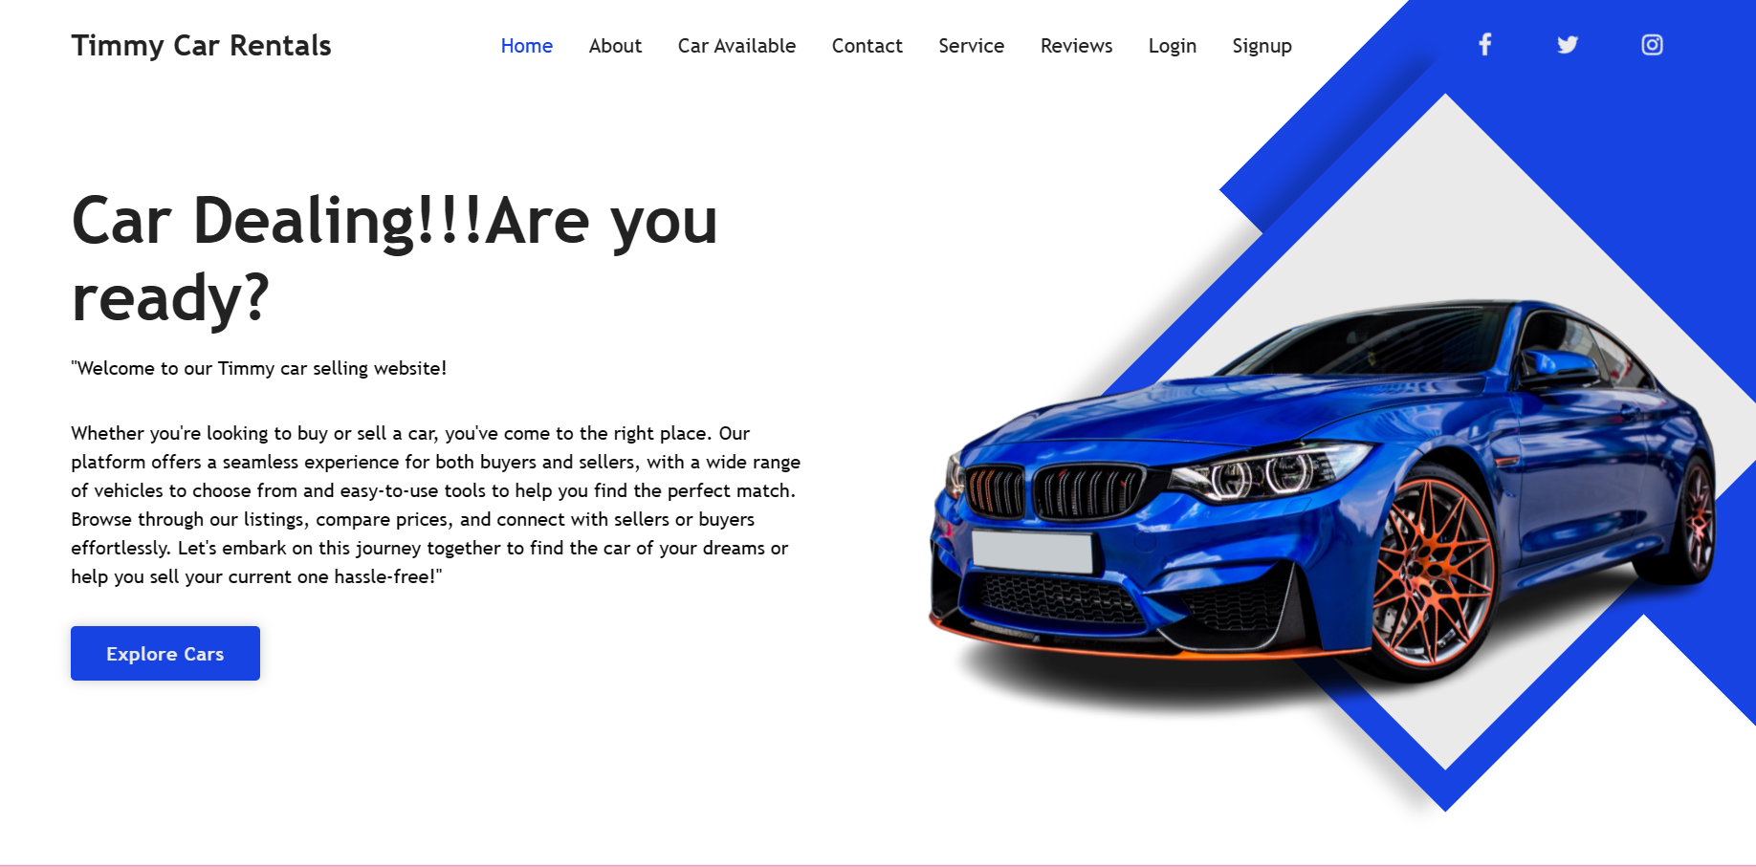
Homepage

Slide 11
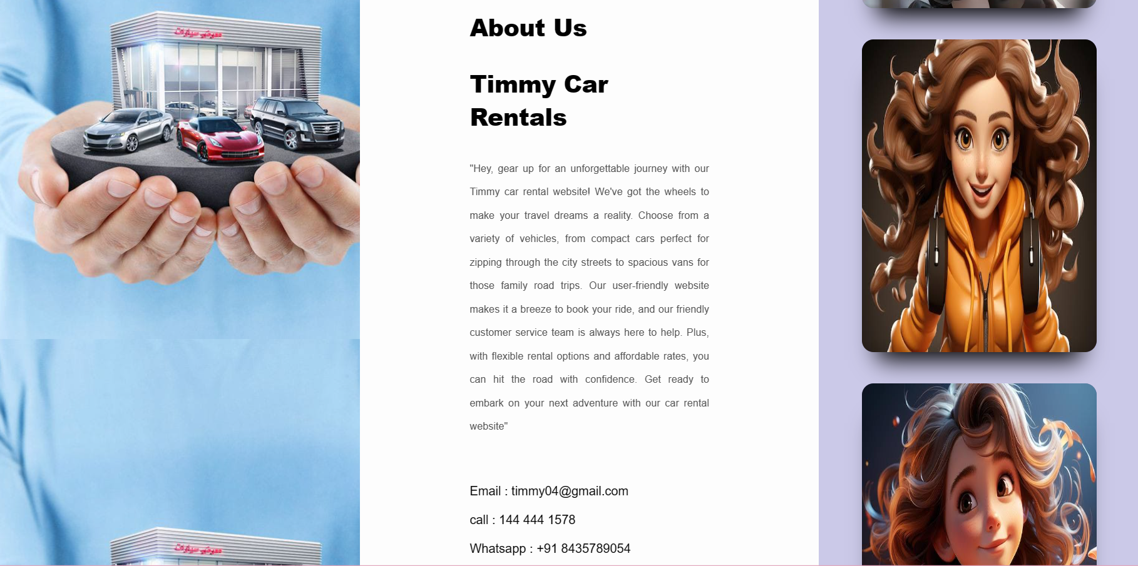
About-Us-Page

Slide 12
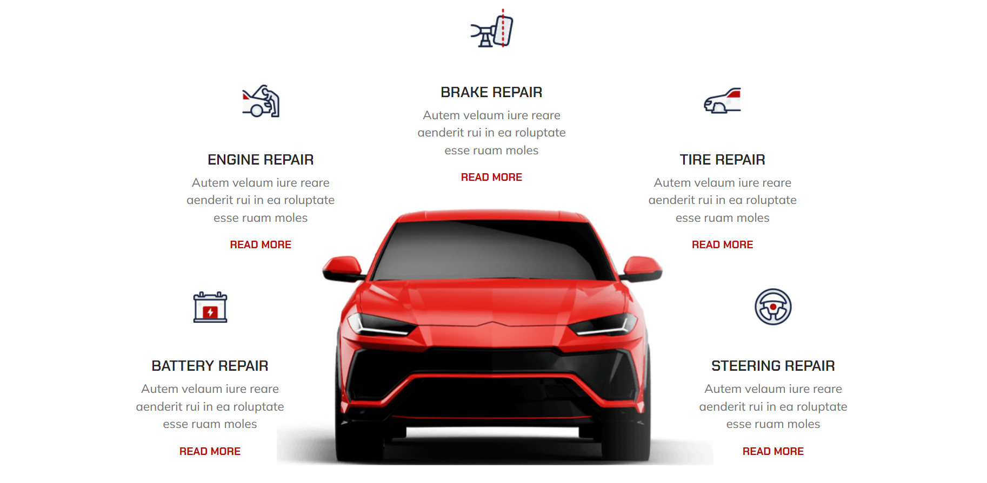
Service-Page

Slide 13
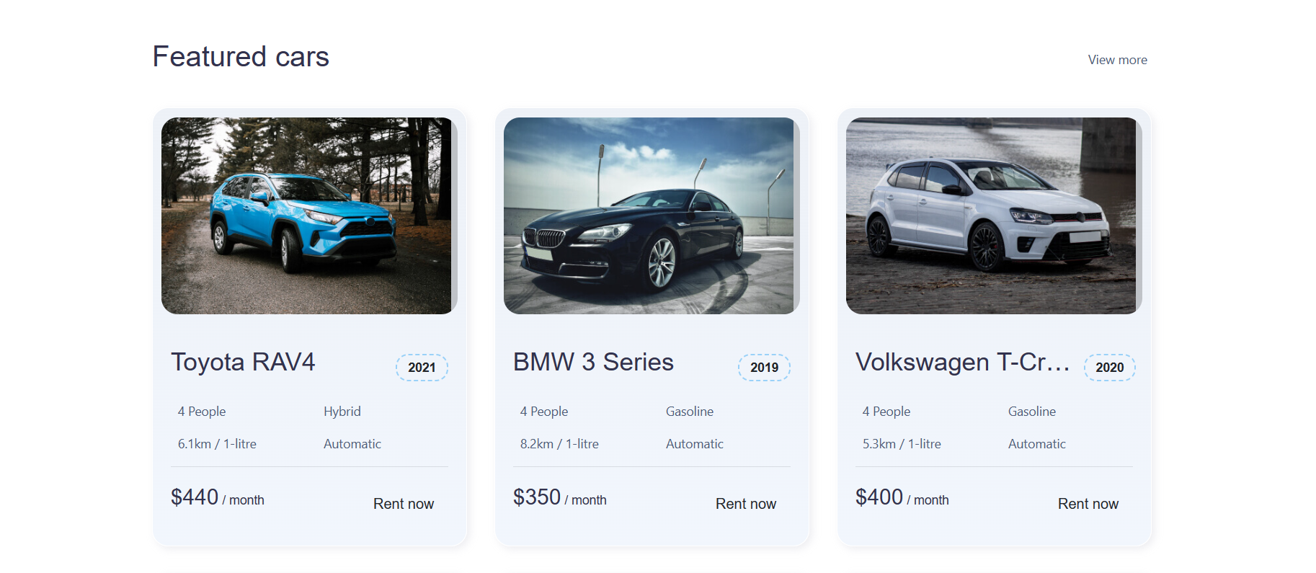
Car Available-Page

Slide 14
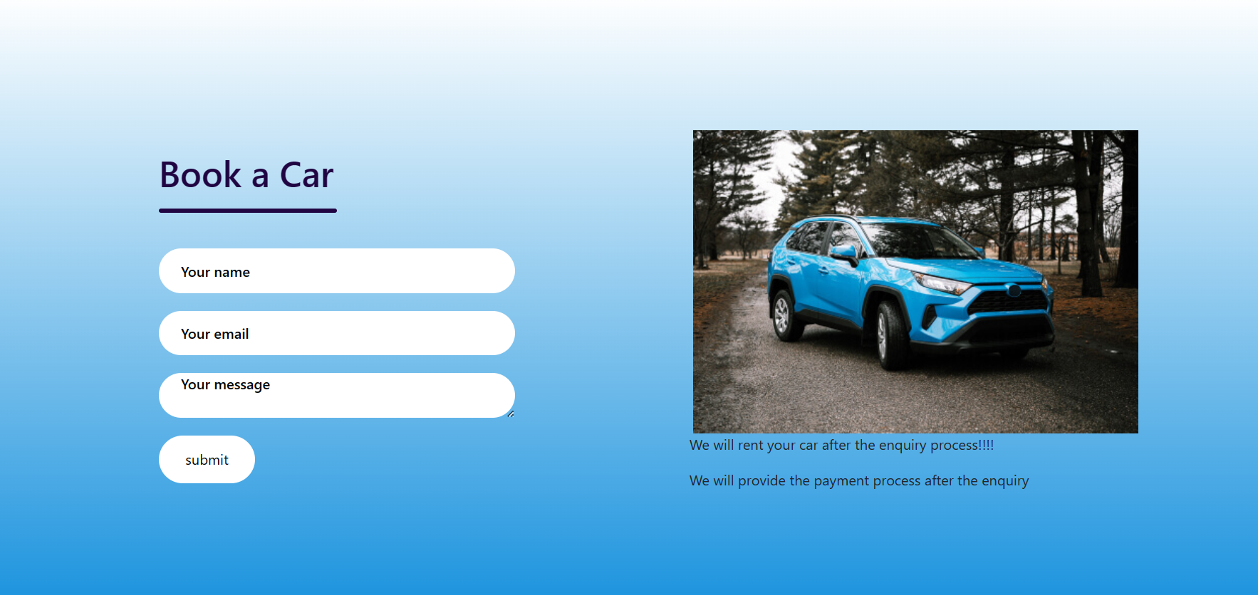
Car Booking-Page

Slide 15
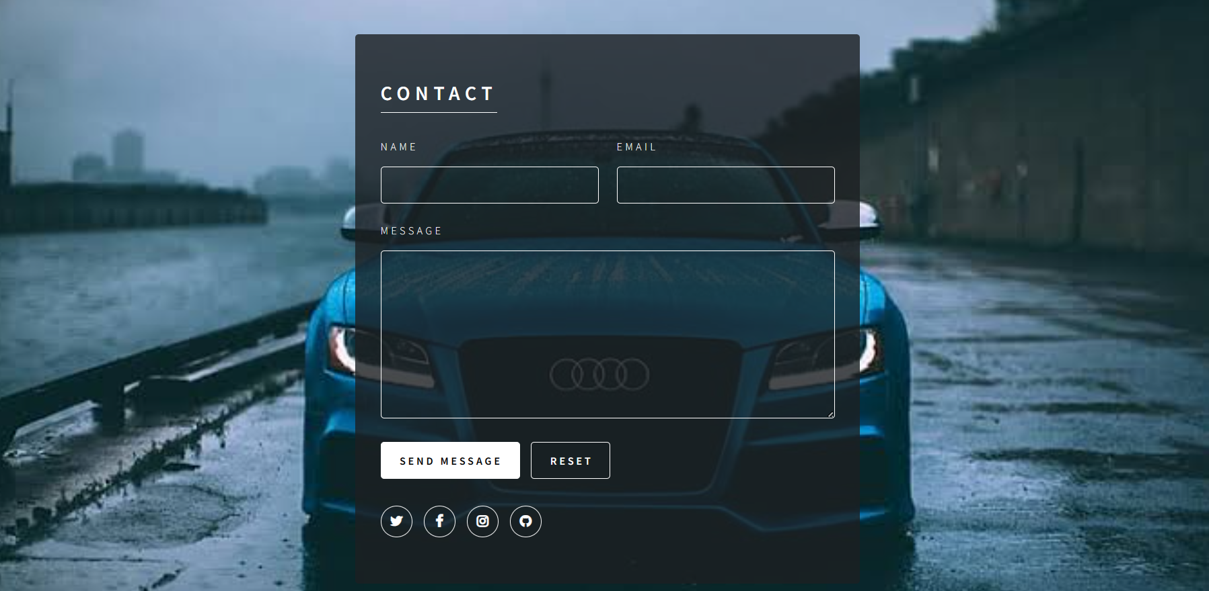
Contact-page

Slide 16
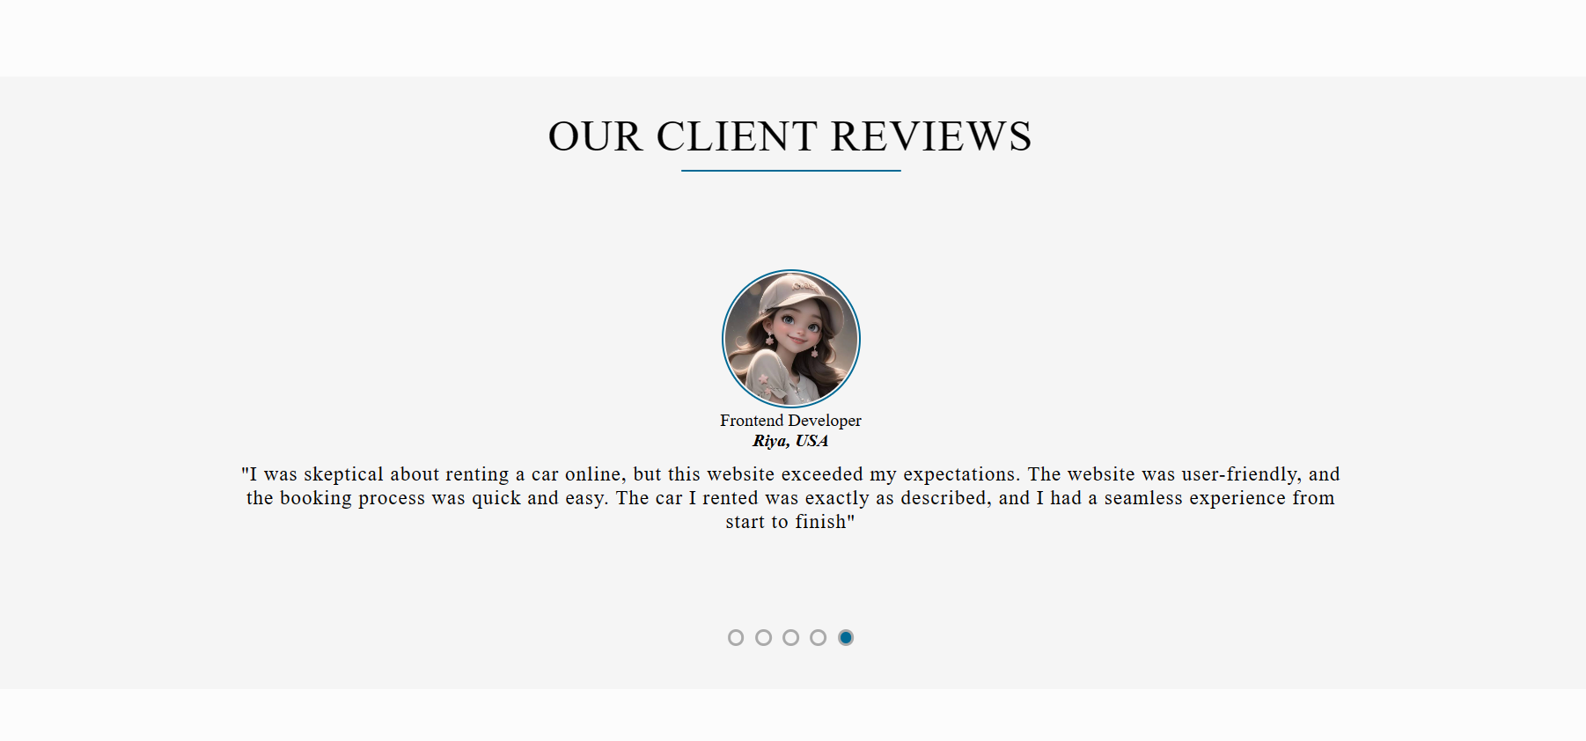
Review Page

Slide 17
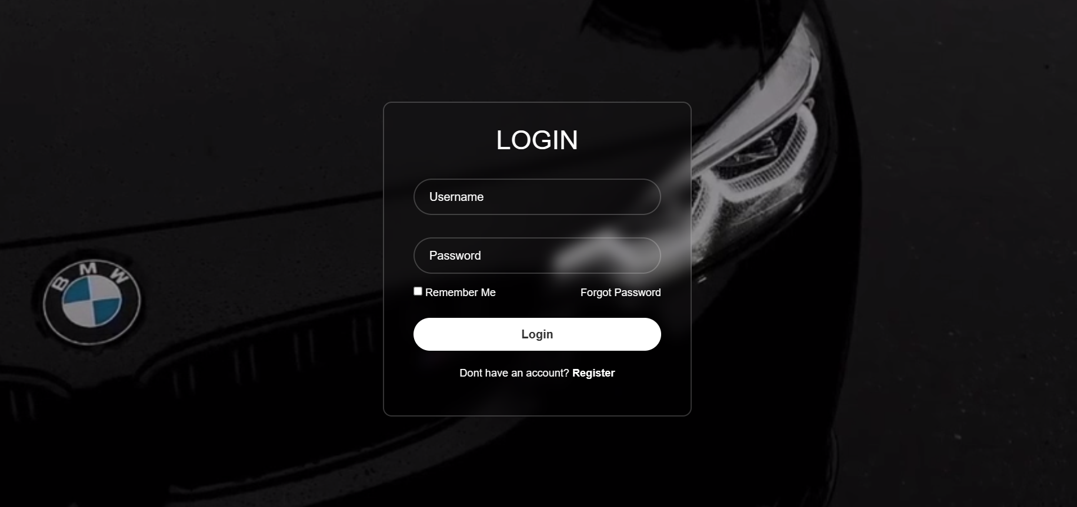
Login Page

Slide 18
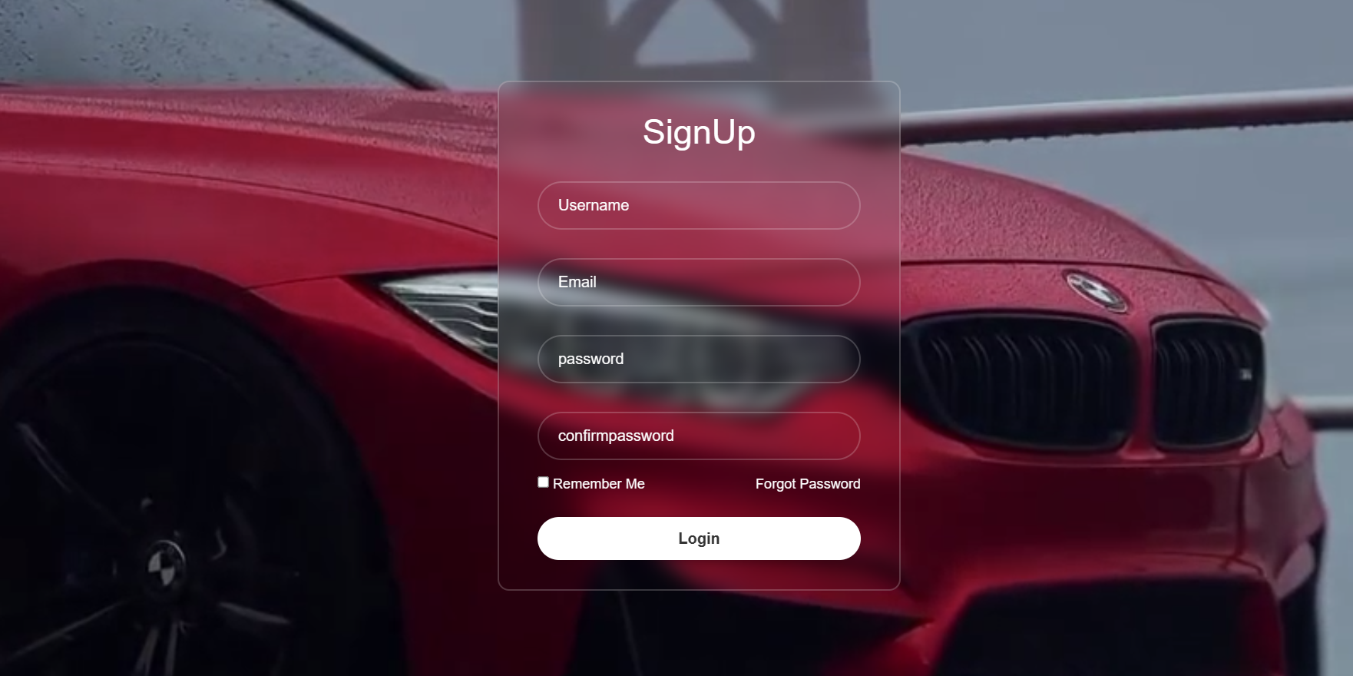
Sign Up page

Slide 19
Future Enhancements:
Advanced Search and Filtering: Enhance the search functionality by adding advanced filters such as car type, price range, location, and availability. This will make it easier for users to find the perfect car for their needs.
Integration with Payment Gateways: Enable secure online payments by integrating popular payment gateways such as PayPal or Stripe. This will provide a seamless and convenient payment experience for your users.
Integration with GPS and Mapping Services: Integrate GPS and mapping services to provide users with real-time location tracking and navigation to the rental car pick-up and drop-off points. This will enhance the user experience and make it easier for them to find their way.

Slide 20
Conclusion
Thanks for visiting our website! We're thrilled to offer you a seamless car rental experience with our amazing Django-powered application. With our user-friendly interface, advanced search options, and secure payment integration, renting your dream car has never been easier. So why wait? Start your adventure today and book your perfect ride with us. We can't wait to help you hit the road in style!
Source :

Slide 21
Thank You!
Notes:
Thank You !!

